Slide 1
ANALYSE AND PREDICT CLIMATE CHANGES
Project Description :--
Here we are analyzing the climate of Rwanda. well, we go into the analysis we know about the
country, Rwanda is a landlocked country in the Great Rift Valley of East Africa, where the African
Great Lakes region and Southeast Africa converge. Located a few degrees south of the Equator.
Rwanda with a distribution around farm lands, cities and power plants. The years 2019 - 2021
data we have taken for analyze, and we have task to predict the CO2 emissions data for 2022
through November.

Slide 2
Discussing about some terms on which Climate change is depended
we have taken the Density : Amount of gas in a vertical column of the atmosphere above a given area.
Density : Amount of gas in a vertical column of the atmosphere above a given area.
Density_Amf : Air Mass Factor (AMF) is a correction factor that relates the amount of gas actually measured by a satellite (slant column) to the amount that would be directly above a point on the ground (vertical column)
Slant Column : The slant column refers to the total amount of a gas measured along the path from the satellite to the Earth’s surface (which is at an angle, not straight down).
Vertical Column=(Slant Column/AMF)
cloud fraction : cloud fraction is a value between 0 and 1 that indicates how much of the sky is covered by clouds in a specific area.
0 → Clear sky (no clouds)
1 → Fully overcast (100% cloud cover)
Azimuth angle : The azimuth angle describes the compass direction from which the sunlight or satellite sensor is viewing a point on Earth.

Slide 3
sensor_zenith_angle : The zenith angle is the angle between: Directly overhead (the zenith, 0°) And the incoming light
(from the Sun or satellite sensor)
solar_zenith_angle : The solar_zenith_angle is the angle between the Sun and the vertical direction (zenith) at a specific
location.
0° → Sun is directly overhead
90° → Sun is on the horizon (sunrise/sunset)
ess than 90° → Sun is below the horizon (nighttime)
Ozone : Ozone is a gas made of three oxygen atoms (O₃)Cloud : Clouds are made of tiny water droplets or ice crystals
suspended in the atmosphere. They form when moist air rises and cools, condensing water vapor.UV
Aerosol Index :The UV Aerosol Index (UVAI) is a satellite-derived measure that detects UV-absorbing aerosols (smoke,dust,ash)

Slide 4
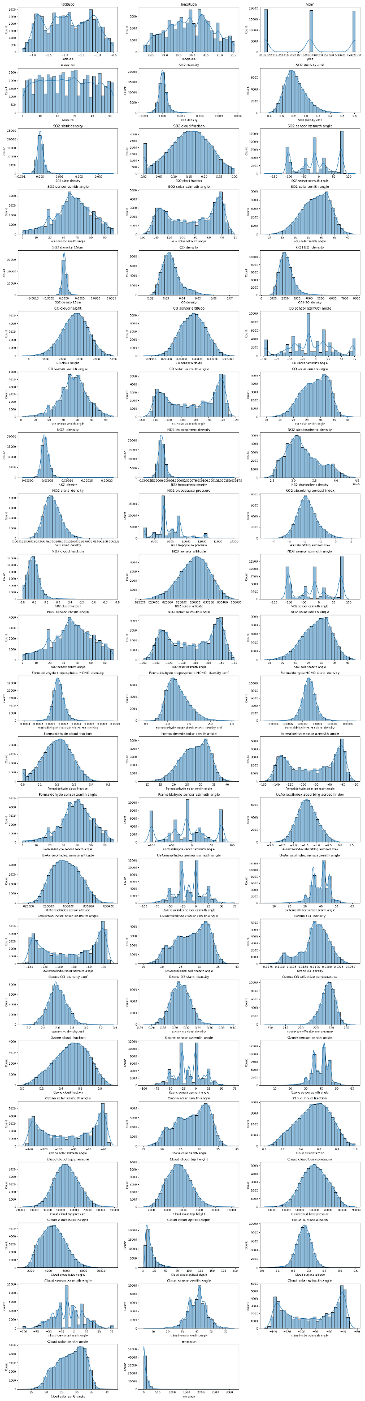
Data flow analysis of each parameters:
From the above graph i have we can clearly say that recording are taken in different day timings
1.Recording taken from the Azimuth angle(sun position to object) are almost Day and night or twilight timings.
The angle is frequency distributed.
2.Recording taken from the zenith angle(sun rays project on object ) are mostly taken on day timings.
The reading angles are normally distrusted.

Slide 5
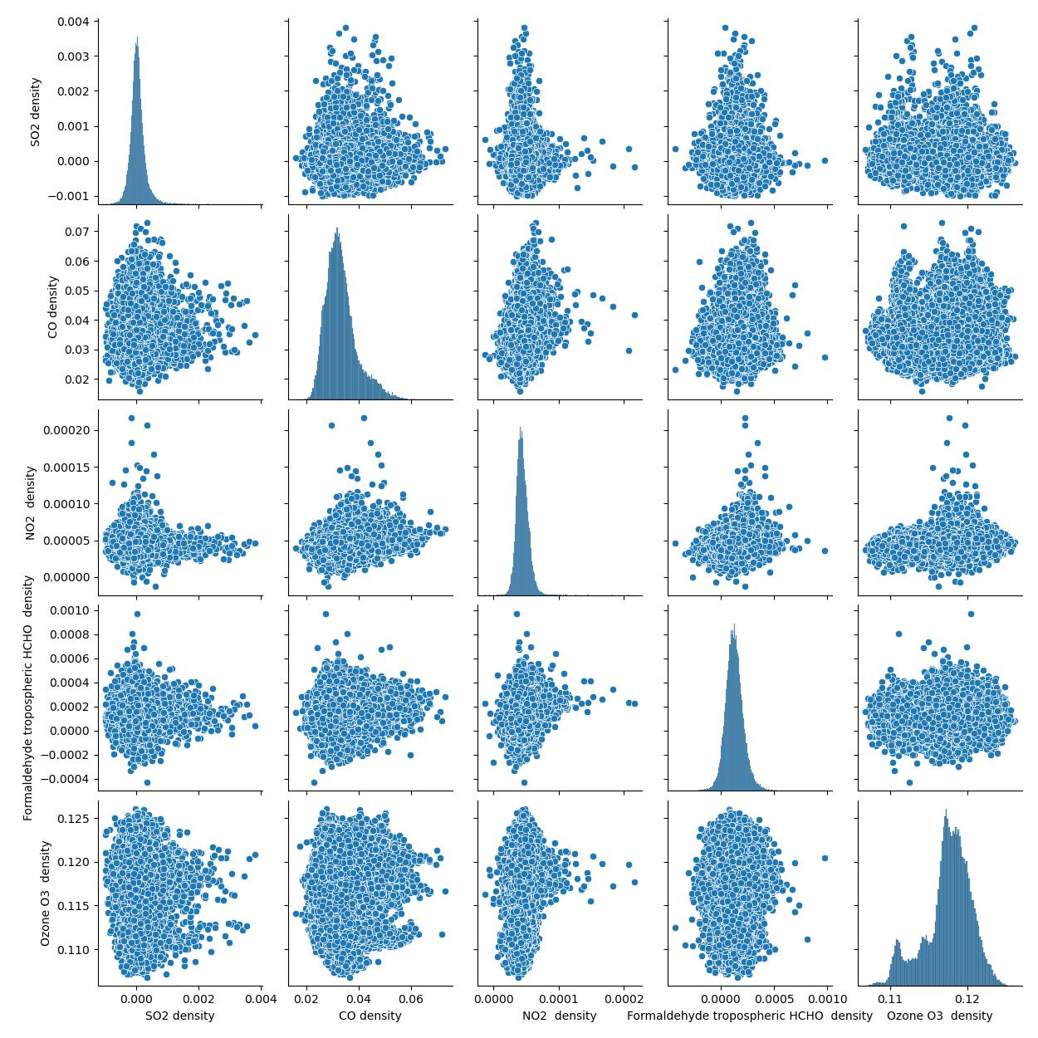
Scatter plots between every pair of numerical features
1. Finding out the correlations, clusters, linear relationships, outliers.
2. show the distribution of each individual feature.
Here we are taking data, where AMF and Slaint density are calculated and final density we get
Vertical Column Density (VCD) = Slant Column Density / AMF
We know that:
Weak Positive Relationships: SO2 shows a weak positive correlation with all others variables.
Moderate Positive Relationships: CO, NO2, and HCHO show moderate positive correlations with each other and with O3.
O3 as a Central Variable: Ozone (O3) density tends to increase as CO, NO2, and HCHO densities increase.

Slide 6
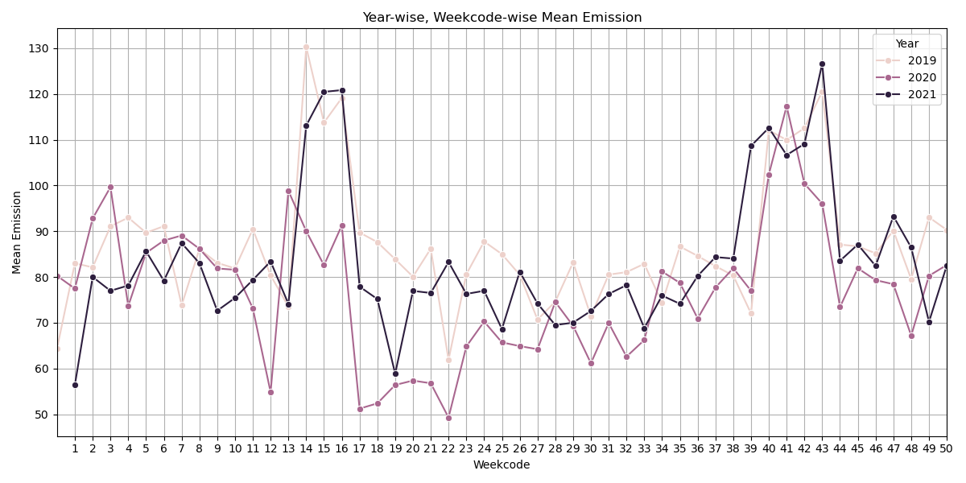
Mean Emissions Per Week (Week code) for the years 2019, 2020, and 2021.
There is a clear seasonal and event-based emission pattern. Year 2020 stands out with a significant drop during mid-year, indicating the impact of the pandemic. Peaks during Weeks 14–16 and 40–44 are consistent, indicating possible recurring high-emission activities.

Slide 7
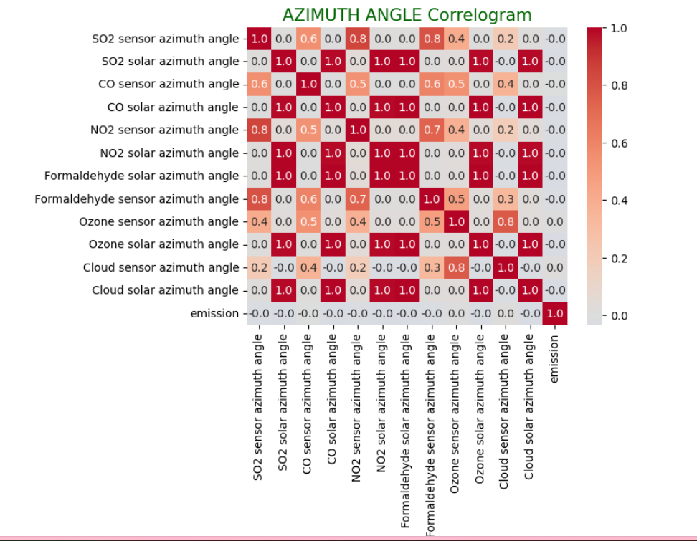
Correlation between all Azimuth Angle
Many columns are perfectly correlated (correlation = 1.0)
All features have very low correlation with emission
This means azimuth angles may not be strong predictors on their own.
So, we can remove this parameters which is not affecting the Predicting on Emission

Slide 8
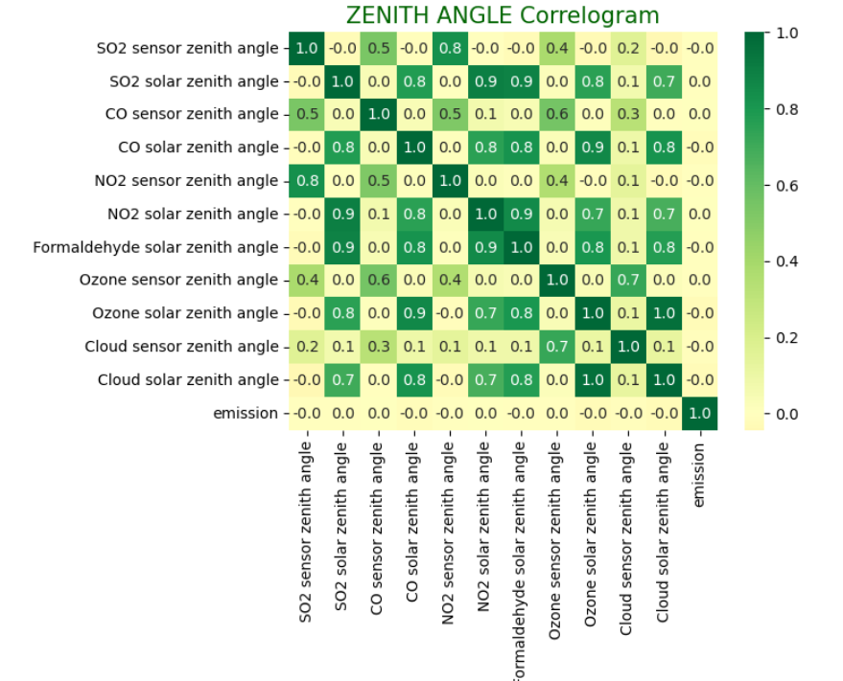
Correlation between all ZenithAngle
High internal correlation among solar zenith angles
Low relationship with emission and this features are less important in predicting the emission
Formaldehyde solar has strong correlation with:
SO₂ solar (0.9)
NO₂ solar (0.9)
Ozone solar (0.9)

Slide 9
We chosen RandomForestRegressor Model for the below reasons:
Random Forest Regressor is a powerful, flexible, and easy-to-use model that’s perfect for your multifeatured, possibly non-linear emission dataset.
Handles Non-Linear Data Well
Robust to Outliers & Noise
No Need for Feature Scaling
Reduces Overfitting
High Accuracy
In this project, we analyzed and modeled environmental emission data using various sensor and solar angle parameters. After performing thorough preprocessing—such as handling missing values, analyzing correlations, and exploring trends—we selected the Random Forest Regressor for prediction modeling.
The model demonstrated exceptionally high performance, achieving:
R² Score: 0.9379
Mean Squared Error (MSE): 1350.39

